Slide 1

How to install a Linux Operating System on a Chromebook

Slide 2
How to install a Linux Operating System on a Chromebook
There are many types of Chrome books. ACER, ASUS, Dell, HP, Lenovo, and Samsung all produce their own as do others.
They come with Chrome OS installed and some have been around since June 2011 in some form or another.
Today they receive 10 years of updates and then they reach end of life.

Slide 3
How to install a Linux Operating System on a Chromebook
A Linux Operating System can be installed on most of them either in the form of a dual boot or replacing the Chrome OS.
For this presentation, we have an ACER Chromebook 11 CB3-111 which we will demonstrate how to replace the Chrome OS.

Slide 4
How to install a Linux Operating System on a Chromebook
If you want to wipe Chrome OS and replace it with Linux (or Windows)
  Go to https://docs.mrchromebox.tech/docs/supported-devices.html to verify that your device has UEFI Full ROM Support
  Put your device in Developer mode
  Disable your device’s hardware firmware write protection (via screw, battery, jumper, or CCD
  Run the Firmware Utility Script
  Flash the EUFI Full ROM Firmware
  Reboot
  Boot and install your new OS

Slide 5
How to install a Linux Operating System on a Chromebook
https://docs.mrchromebox.tech/docs/supported-devices.html

Slide 6
Put Device in Developer Mode
First boot to Recovery Mode
press Esc + Refresh + Power at the same time
Press Ctrl + D (This will bring up a warning asking for confirmation for either “Turn OS Verification Off” or “Enable Developer Mode”
Press Ctrl + D (to boot from internal disk)
Connect to a network as usual, but do not enable debugging features

Slide 7
Getting a Root Capable Shell
On login screen, press Ctrl + Alt + F2 (F2 is the right arrow)
Then login with user chronos (no password is required)

Slide 8
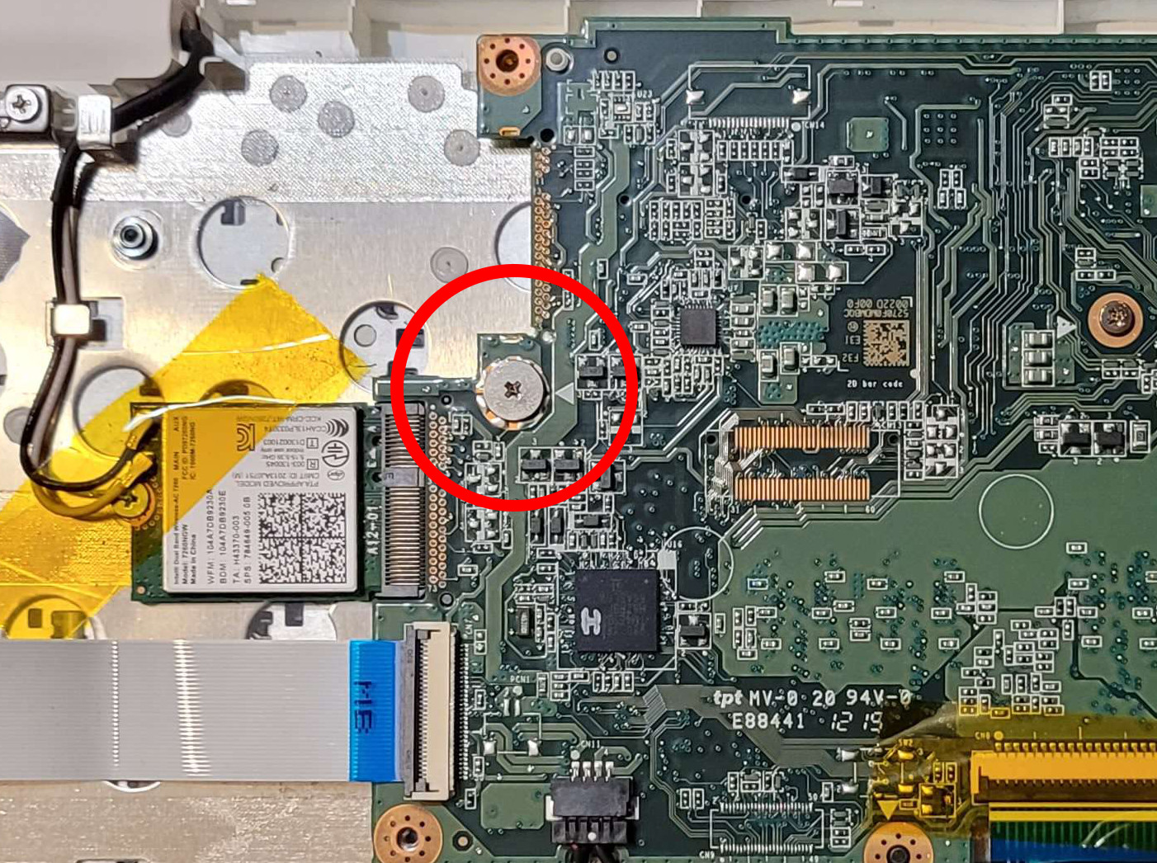
Disable device Hardware Firmware Write Protection

Slide 9
Run Firmware Utility Script
To download and run this script under Chrome or Linux from a terminal/shell type:
cd: curl -LO mrchromebox.tech/firmware/util.sh && sudo bash firmware/util.sh
Press enter
Only the script functions available for the device are enabled

Slide 10
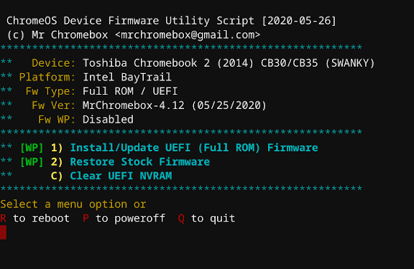
Flash the EUFI Full ROM Firmware

Slide 11
Flash the EUFI Full ROM Firmware
After installing the UEFI (Full ROM) Firmware, your device will boot directly in UEFI Mode; ChromeOS will not be able boot. Your ChromeOS device is now a "regular PC," and you can install the OS of your choice without any special instructions.

Slide 12
Reboot and install your new OS
If your Chromebook has less than 4 Gbs of RAM you should choose an OS that will run effectively with that RAM.
Note Ubuntu and Kubuntu require at least that amount so a DE which requires less should be selected. Linux Mint (Cinnamon) is also fairly heavy so choose a lighter version (xfce or Mate).

Slide 13
How to install a Linux Operating System on a Chromebook
If you want to dual boot with the Chrome OS
  Go to https://docs.mrchromebox.tech/docs/supported-devices.html to verify that your device has RW_LEGACY support
  Put your device in Developer mode
  Run the Firmware Utility Script
  Flash the RW_LEGACY Firmware
  Reboot
  Press (Ctrl + L) to boot in Legacy mode /AltFw menu
  Boot and install your new OS

